Slide 1
Crime in Austin, Insights
Quinci Henry

Slide 2





Background
The city of Austin houses data online for occurrences of arrests. My goal was to glean this data for insights into how the city is policed and by extension how the city can be policed more efficiently and justly.
Tech Stack

Slide 3
Understanding the Data: [~159k entries, ~18% fully populated row wise] https://www.kaggle.com/jboysen/austin-crime
Time
Location
Status
Clearance date
Arrest date
Year (2014 - 2015)
Census Tract
Zipcode
Address
District
X,Y coordinate
Longitude & Latitude
Cleared
Primary Type (of crime)
Description
Notes:
Move this back to original order

Slide 4
Fields of Interest Post Initial EDA
Longitude/ Latitude and X,Y Coordinates - Good indicator of a useful data point
Clearance Status - Tertiary indicator whether case is solved
Description - More specific account of the event
Primary Type - More broad account of the event
Timestamp - Day the event took place ( unfortunately no time of day included)

Slide 5
Understanding the Data: https://www.kaggle.com/jboysen/austin-crime [~159k entries]
Time
Location
Status
Clearance date
Arrest date
Year (2014 - 2015)
Census Tract
Zipcode
Address
District
X,Y coordinate
Longitude & Latitude
Cleared
Primary Type (of crime)
Description
https://www.google.com/url?q=https://www.kaggle.com/jboysen/austin-crime&sa=D&source=editors&ust=1624321585655000&usg=AOvVaw3CunJWEXsTrxAxc42kPZag
*Most entries contained empty values in a number of columns. Only ~18% of the entries were fully detailed.

Slide 6
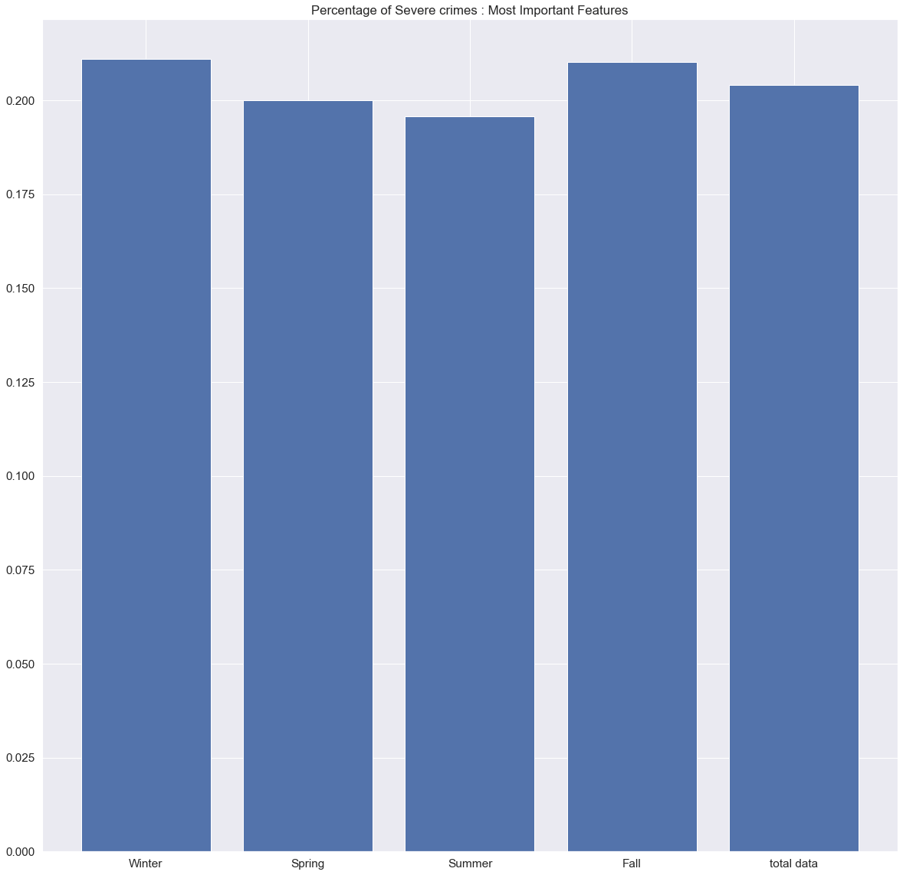
Winter
Fall
Spring
Summer
All Data

Slide 7
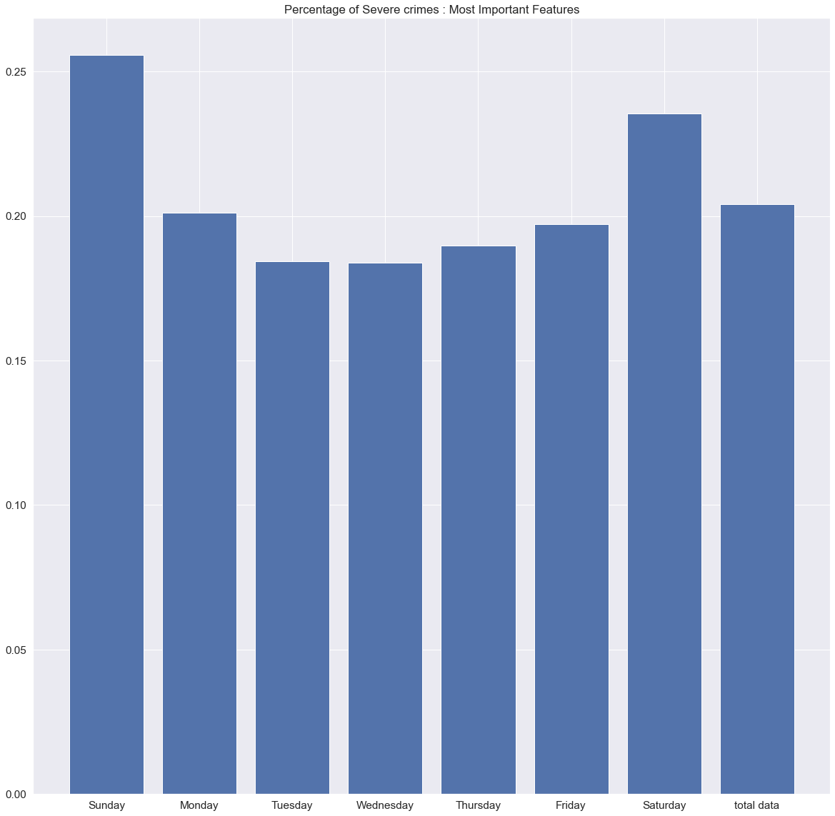
Sunday
Monday
Tuesday
Wednesday
Thursday
Friday
Saturday
All Data

Slide 8
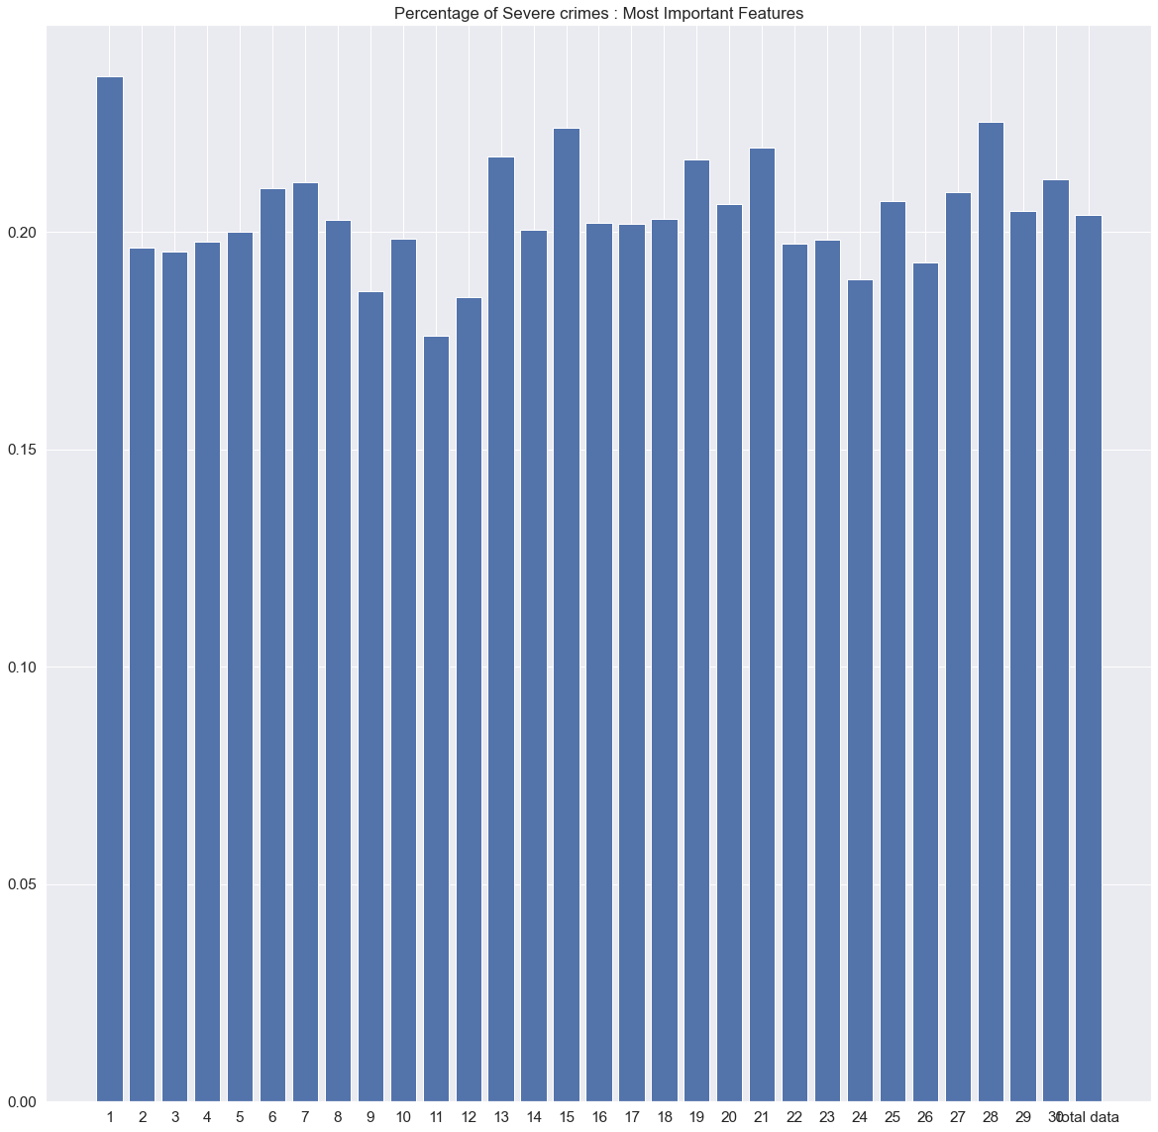
Notes:
Include day 31

Slide 9
Understanding the Data: [~159k entries, ~18% fully populated row wise] https://www.kaggle.com/jboysen/austin-crime
Time
Location
Status
Clearance date
Arrest date
Year (2014 - 2015)
Census Tract
Zipcode
Address
District
X,Y coordinate
Longitude & Latitude
Cleared
Primary Type (of crime)
Description

Slide 10
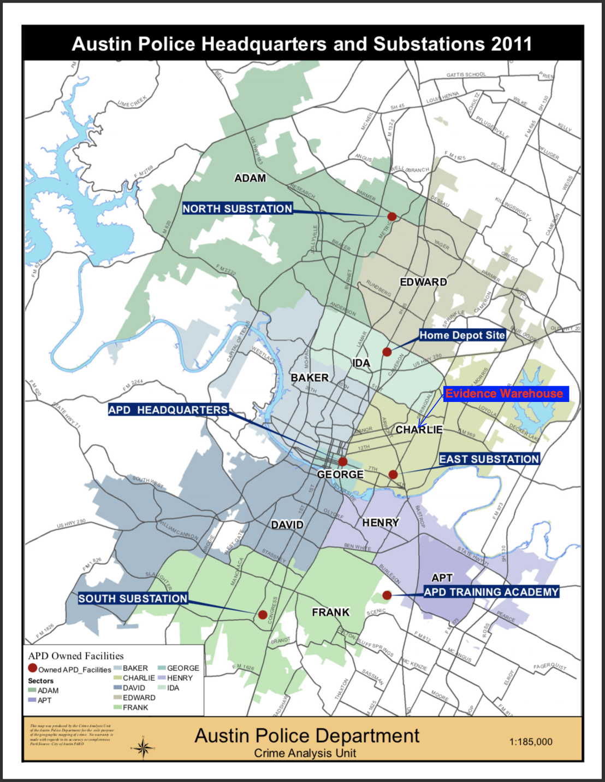
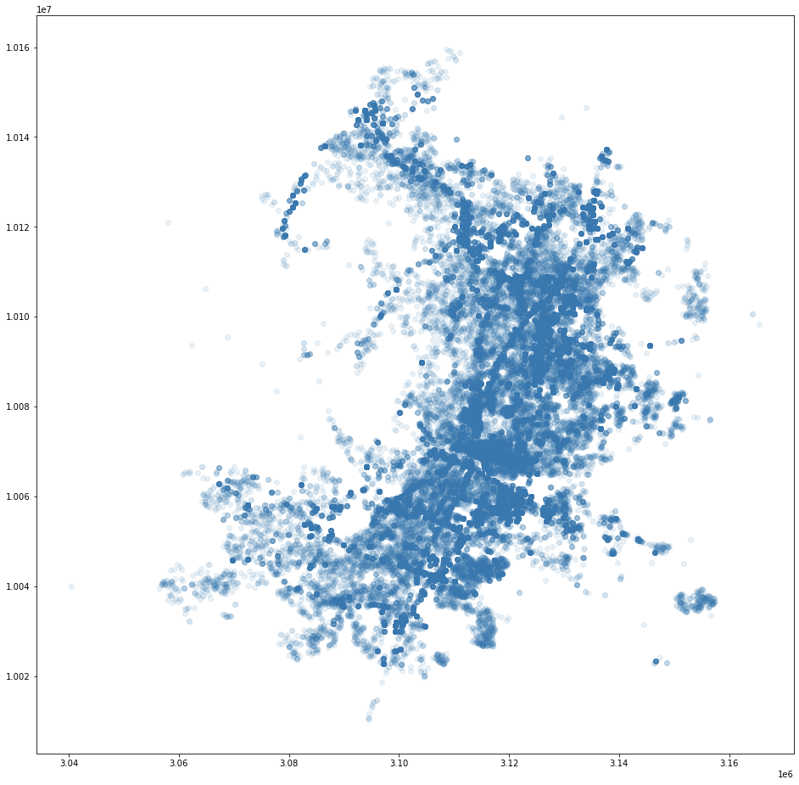
X,Y Coordinate

Slide 11
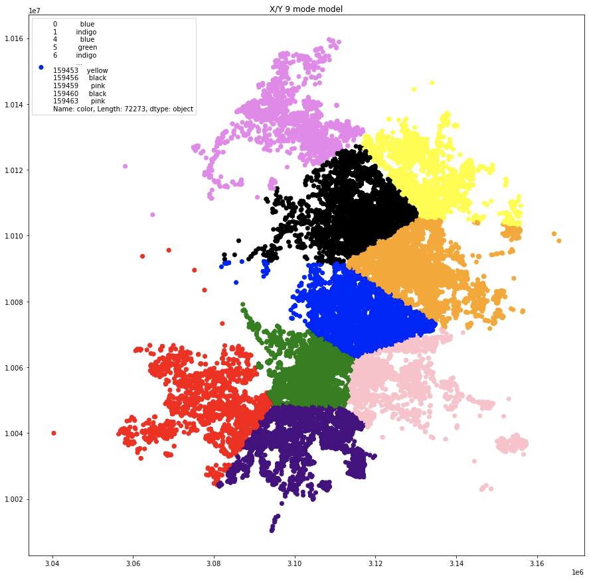
K-Means Clusters ( # of clusters = k = 9) on X/Y
The clusters to the right were each assigned a number. Each data entry then received a new ‘cluster’ value in the dataset. The cluster value matches that of the cluster the entry belongs to.

Slide 12
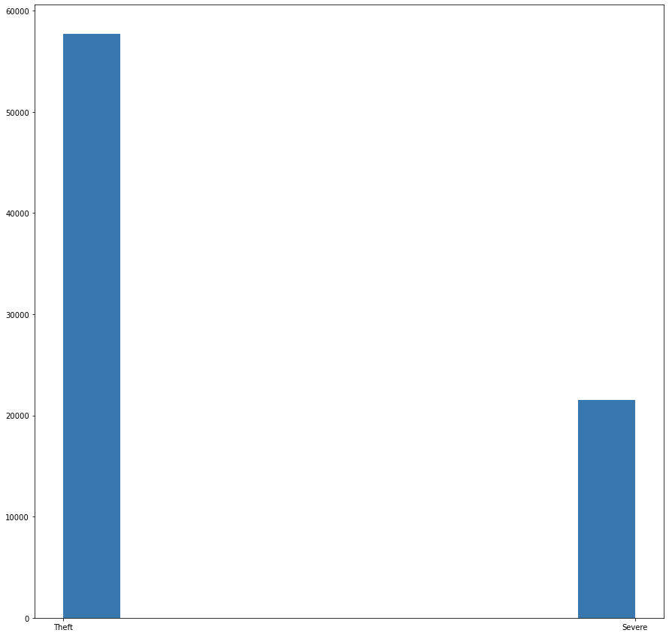
Primary_Type ---> Severe
Crimes I labeled ‘severe’
Burglary
Agg Assault
‘'Burglary / “
Aggravated Assault,
Rape
Robbery
Homicide: Murder & Nonnegligent Manslaughter
Murder
Crimes I did not label ‘severe:
'Theft' , ‘'Theft: Shoplifting', 'Theft: All Other Larceny', ‘Theft: BOV', ‘Theft: from Building', 'Theft: Pocket Picking', 'Theft: Auto Parts', ‘'Theft: Coin Op Machine','Theft: Purse Snatching'
Non-Severe
Severe
Notes:
2 vertical lists

Slide 13
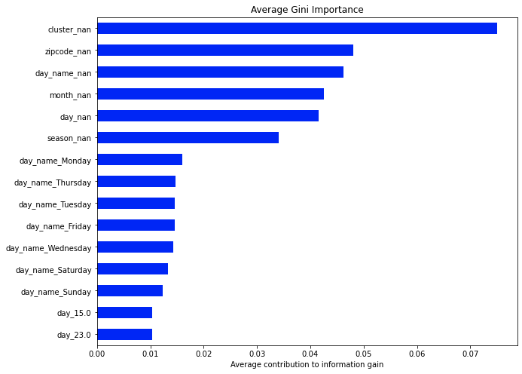
Machine Learning Prediction : Random Forest
Model A
Input: All data that had lat/long or xy coordinates, nan’s included
Output: Crime as ‘severe’ or ‘non-severe’
Accuracy ~ 77.6 % Precision ~ 85.4%
Recall ~ 66%
**Insight: There was a particular severe crime, ‘Burglary \’ in which NaNs were prevalent , possible security/privacy measure
Notes:
Show precision/ recall

Slide 14
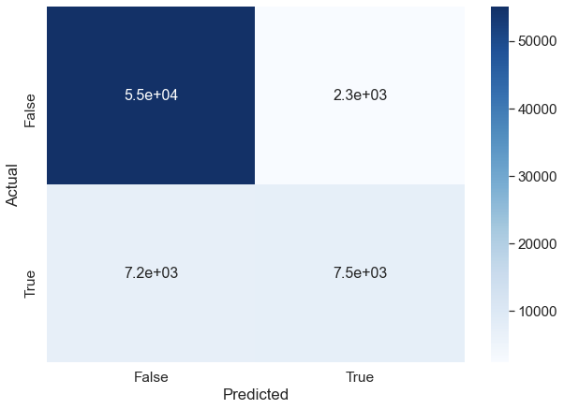
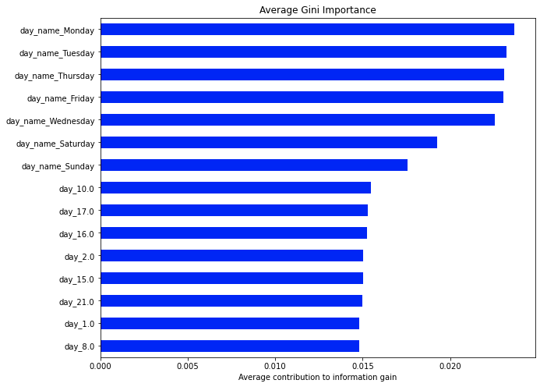
Model B: Dropped all null values
Was the Crime Severe??
Accuracy ~ 76 % Precision ~ 76%
Recall ~ 50%
*Note: No locational data was in the top 20 in terms of Gini Importance for this model. Temporal values were more informative

Slide 15
Conclusions
Under this model, and these location approximations, i.e. [ Census Tract, Zip Code, Address, District, X,Y coordinate, Longitude & Latitude], the time of day, month, and year were each more valuable than each location metric as to predicting the occurrence of a severe crime.
Perhaps a more advanced clustering mechanism would allow for locational data to match the predictive power of a point in time

Slide 16
Future Work
Use ‘Clearance Status’ as target target
Use ‘Clearance Date’ minus ‘Arrest Date’ as feature
Find out severe crime rate by cluster, plot as heat map
Visualize which clusters are where
Explore with 10 clusters
Explore by year

Slide 17
Questions?
Email : qnchenry@gmail.com
Github: github.com/qnchenry-q
LinkedIn: www.linkedin.com/in/quinci-henry
Special Thanks to all Galvanize staff and fellow students

